Slide 1
Match the correct scenario to the tropism.
Vines wrapping around a stake.
Positive Phototropism
Negative Geotropism
Plants bend towards light.
Shoots Growing Upwards
Positive thigmotropism
Roots Growing Downwards.
Positive Geotropism

Slide 2
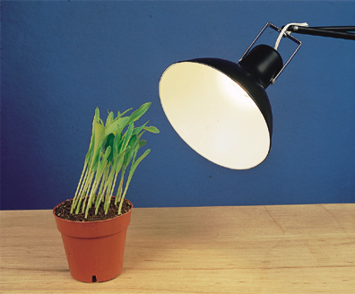
POSITIVE PHOTOTROPISM

Slide 3
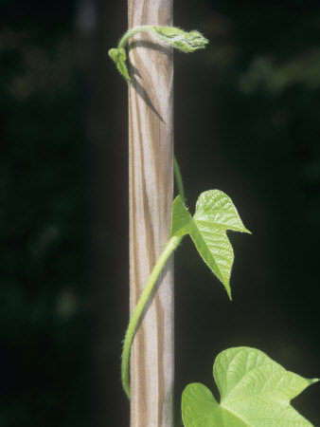
POSITIVE THIGMOTROPISM

Slide 4
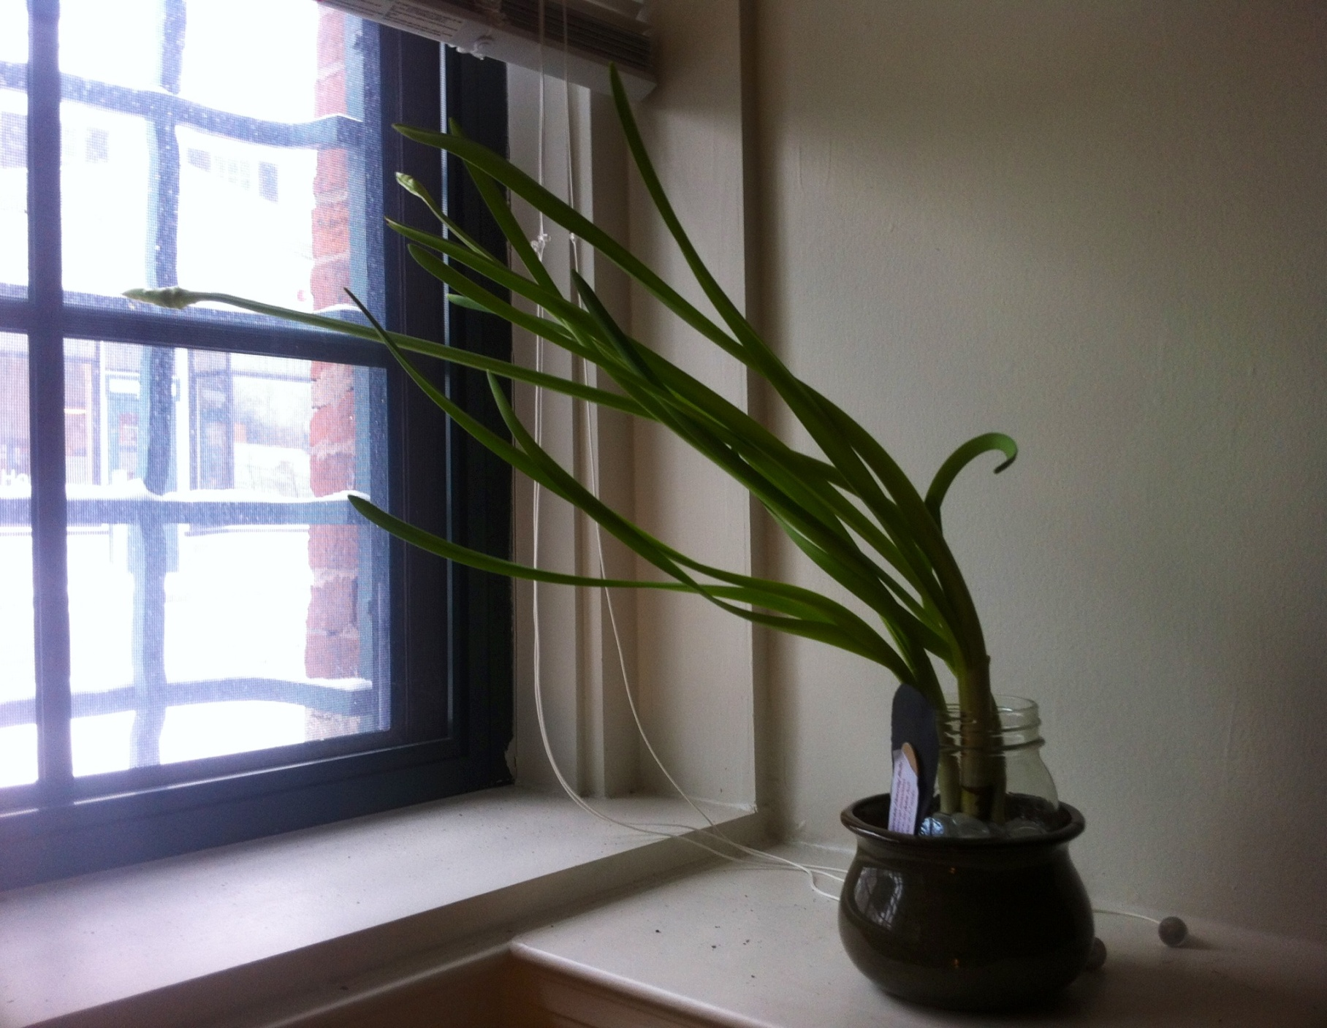
POSITIVE PHOTOTROPISM

Slide 5
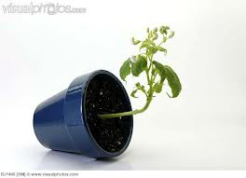
NEGATIVE GEOTROPISM

Slide 6
Growth in response to gravity
GEOTROPISM

Slide 7
Growth in response to touch
THIGMOTROPISM

Slide 8
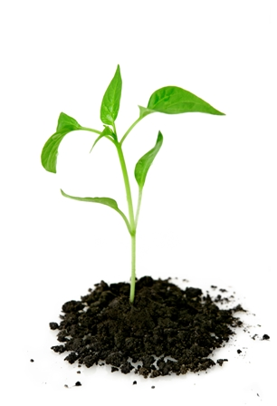
NEGATIVE GEOTROPISM

Slide 9
Roots growing downward into soil
POSITIVE GEOTROPISM

Slide 10
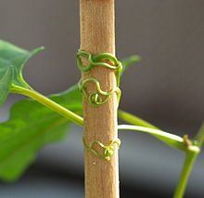
POSITIVE THIGMOTROPISM

